Slide 1
Push & Slide using HER & DDPG
Yu Chen
Yuan Zhang

Slide 2
Reference Paper
Andrychowicz, M., Wolski, F., Ray, A., Schneider, J., Fong, R., Welinder, P., ... & Zaremba, W. (2017). Hindsight experience replay. In Advances in Neural Information Processing Systems(pp. 5048-5058).
Lillicrap, T. P., Hunt, J. J., Pritzel, A., Heess, N., Erez, T., Tassa, Y., ... & Wierstra, D. (2015). Continuous control with deep reinforcement learning. arXiv preprint arXiv:1509.02971.

Slide 3
Push & Slide
Square slippery table
Probe push puck
Puck move and slide
Move = -1
Out of table = -1 & end
Target = 0 & end

Slide 4
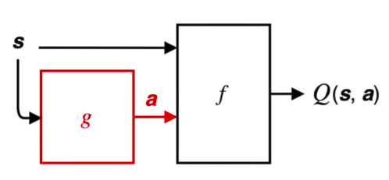
Deep Deterministic Policy Gradients (DDPG)
Model-free RL algorithm for continuous action spaces
Deterministic policy: g
Goal: to find f that maximize expectation
Two neural networks:
target policy (actor)
action-value function approximator (critic)

Slide 5
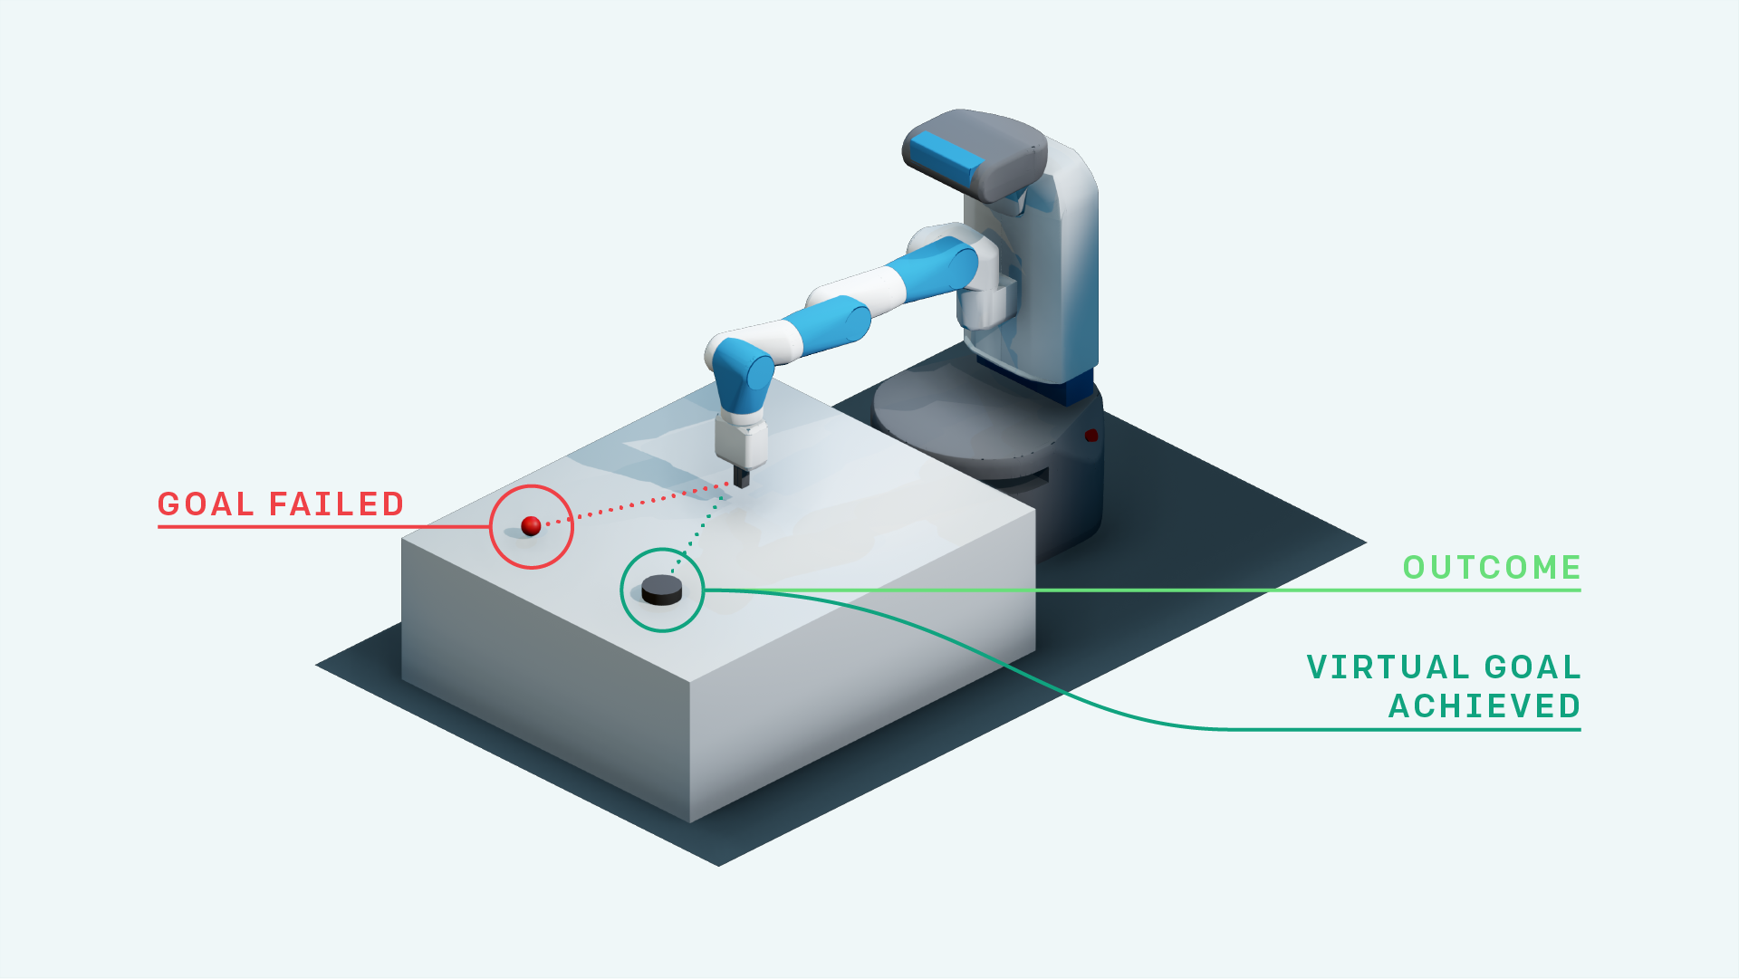
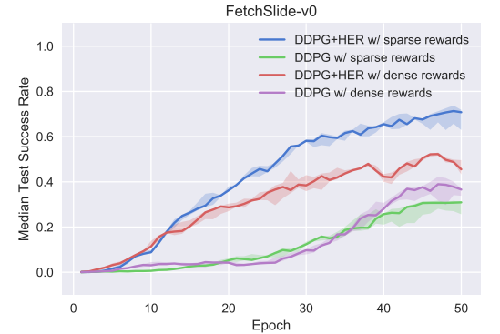
Hindsight Experience Replay (HER)
Sparse and binary rewards (reward engineering?)
Multi-goal
Replay buffer
Fetch Slide
Slippery table with friction
Out of the robot’s reach
Hit the puck to slide
Stop at target position

Slide 6
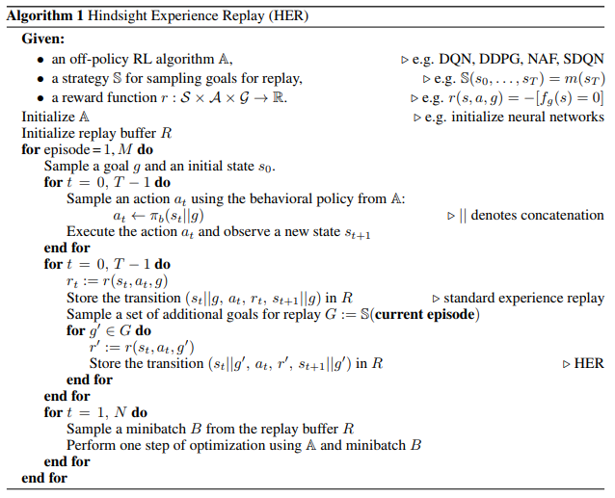
Hindsight Experience Replay (HER)

Slide 7
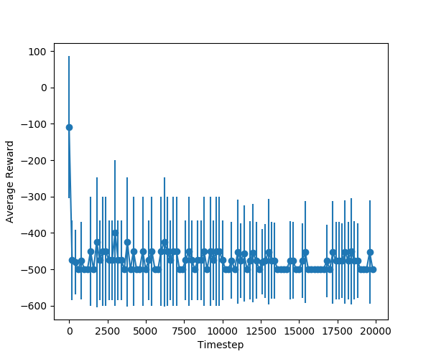
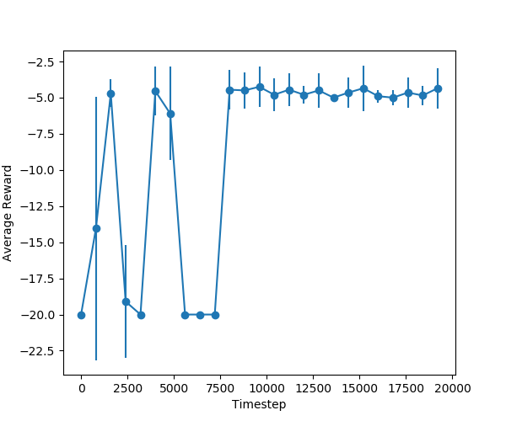
Result
DDPG

Slide 8
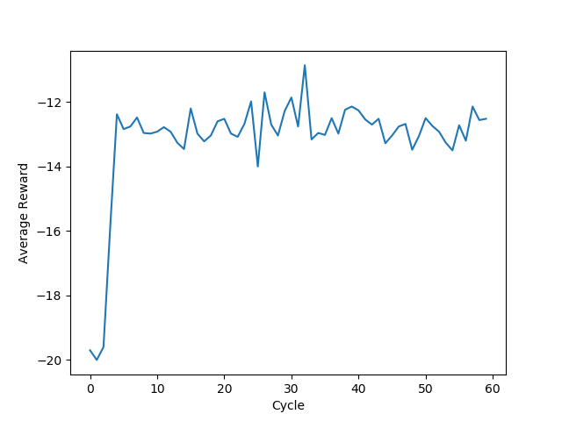
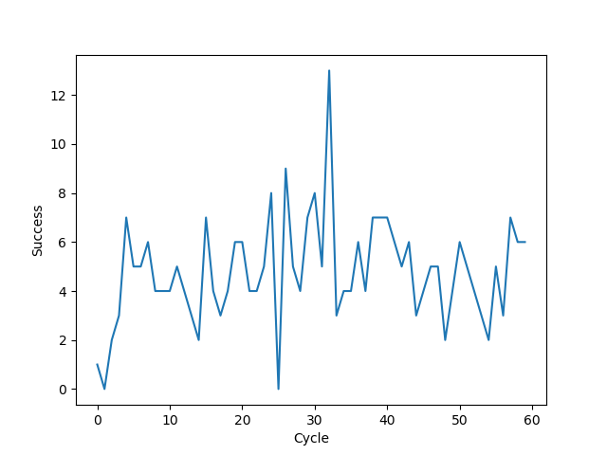
Result
DDPG+HER
Drop = -10

Slide 9
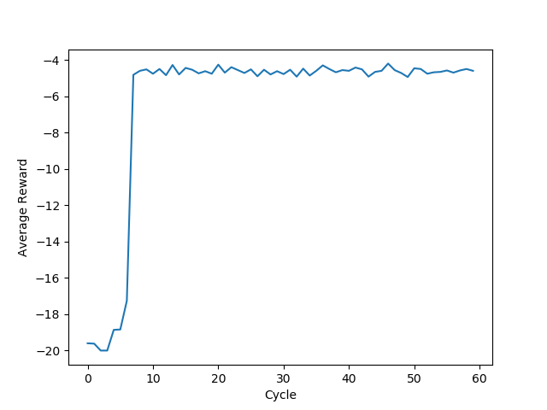
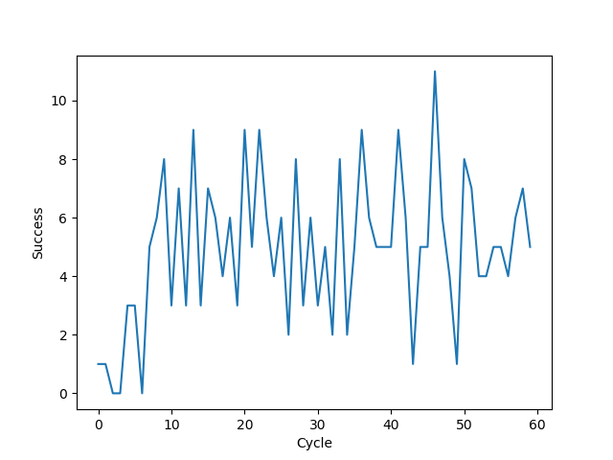
Result
DDPG+HER
1 cycle = 50 epoch
15% success rate

Slide 10
Thanks for listening!
Push & Slide using
HER & DDPG
Yu Chen, Yuan Zhang

